Slide 1
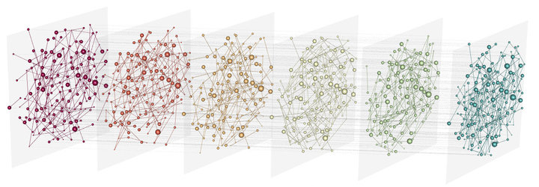


Integrative Genomics:
Introduction and application to metagenomics
2024/06
Vincent Manzanilla
UMR Quito
Notes:
Comment peux ton integrer des donnees diverses/heterogenes avec leurs specificites propres de facon statistiquement robuste ? (integrative genomics)
Comment aller chercher de l’information / de la connaissance et la structurer de facon a repondre aux questions scientifiques ? (ontologies – web semantique)

Slide 2
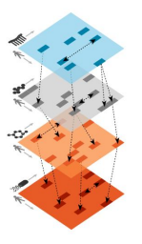
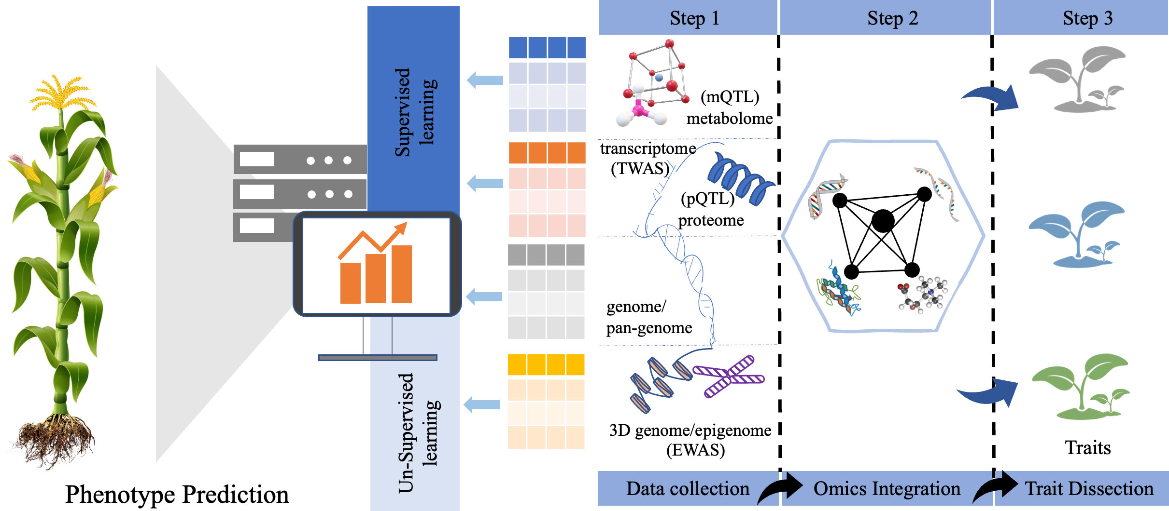
Integration: biological motivation
Deep insights into complex biological phenomenon
Subtyping and classification (disease, species, varieties)
Prediction, diagnostic, identify drivers, selection...
Mahmood et al (2022). Multi-omics revolution to promote plant breeding efficiency. Front Plant Sci.

Slide 3

Integration: motivation and challenges
Integrative genomics is about aggregating heterogeneous data in a statistical fashion.
Take advantage of the vast amount of available data
  Data access (local/national regulation, infrastructures...)
  Data representation (structuration, ontologies...)
  -> Need of common representation framework
Improve our understanding of biological phenomena
  Data heterogeneity (technology, format, biological meaning, stat. distribution...)
  Data complexity (dependances/independances, ad-hoc assumptions...)
  Amount a data (time/memory consuming)
-> Need of new analysis methods/algorithms

Slide 4
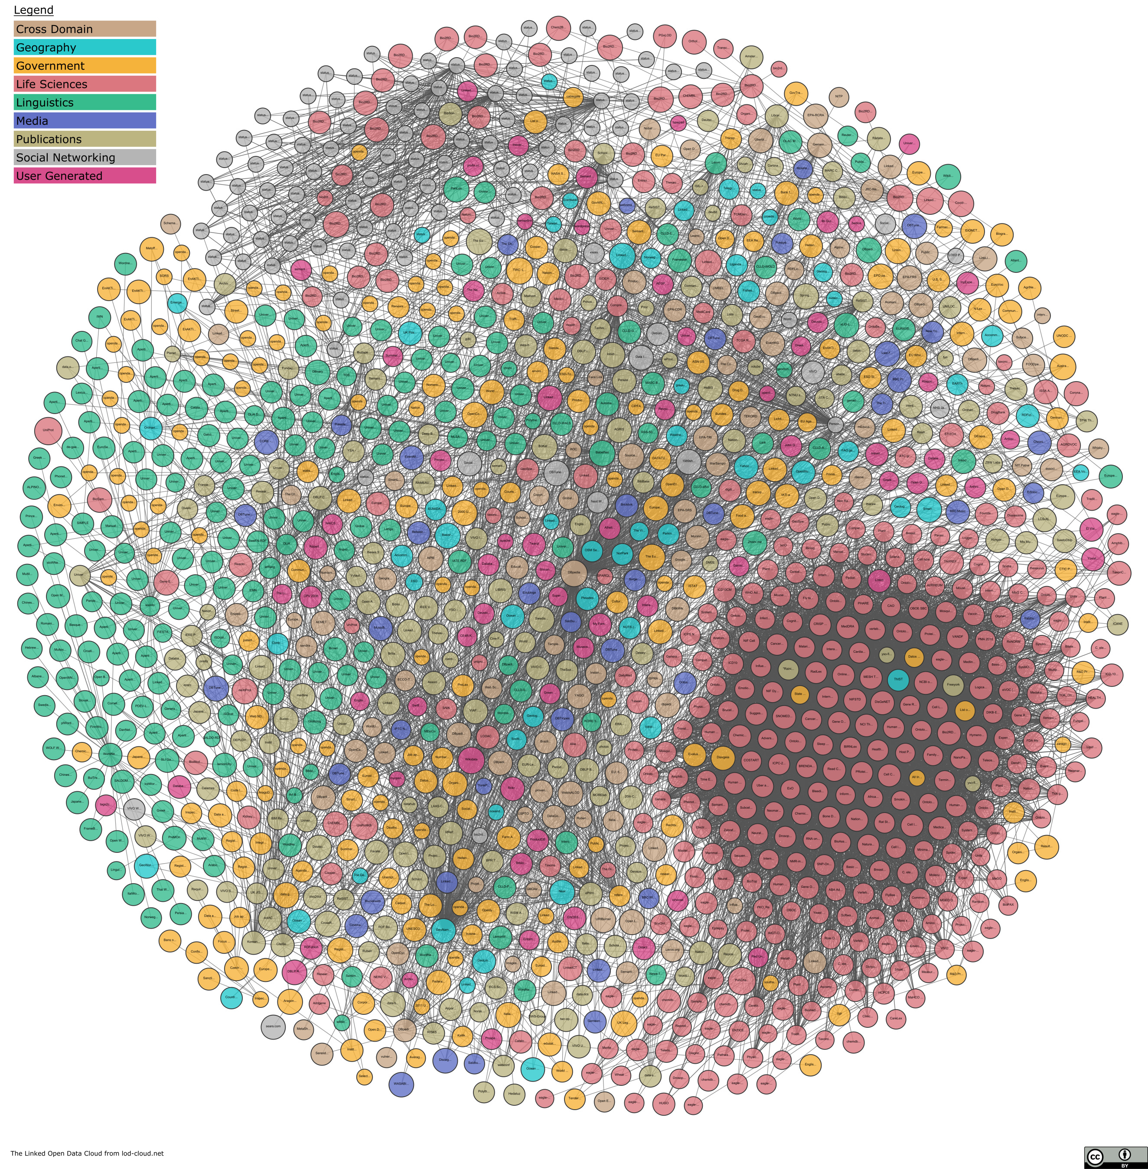
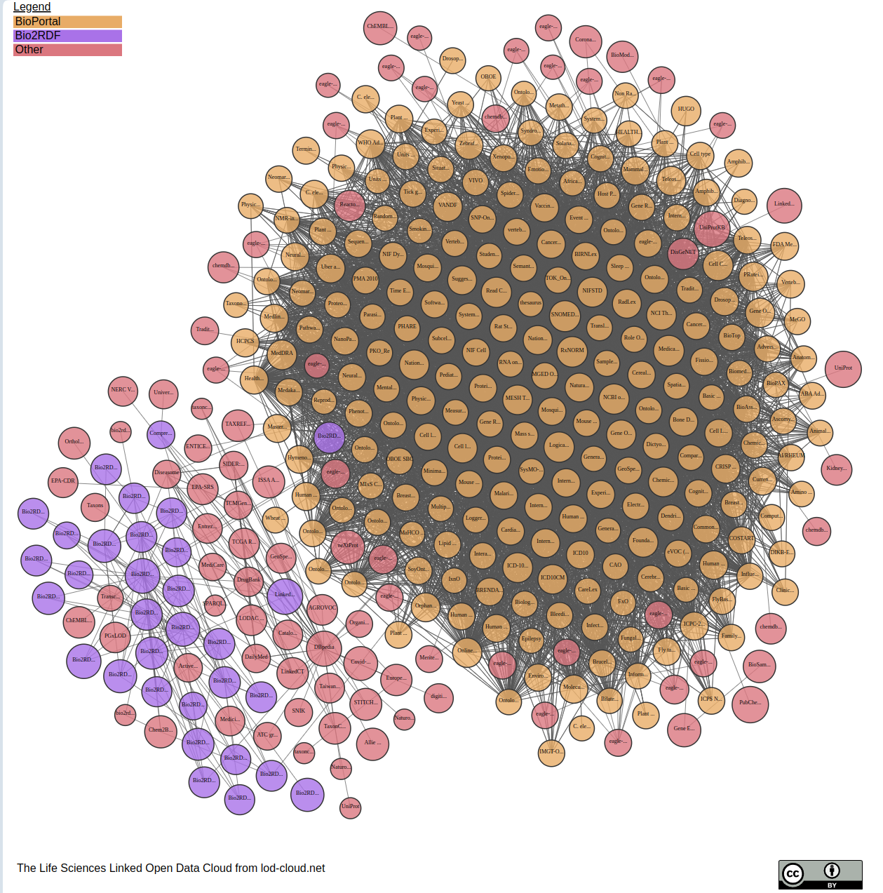
Integration: how?
Life sciences
Improve our understanding of biological phenomena
Take advantage of the vast amount of available data
Semantic Web = framework for:
  integrating data and knowledge
  querying
  reasoning
The Linked Open Data Cloud
https://lod-cloud.net

Slide 5
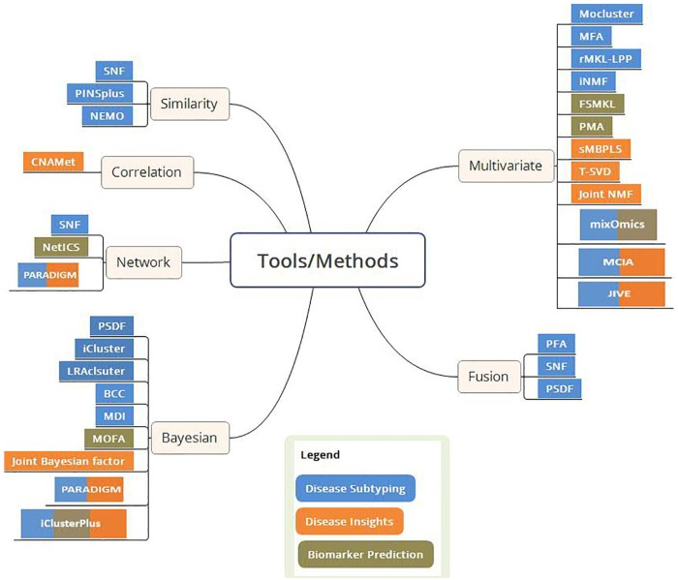
Integration approaches
Web Semantic
Subramanian I, Verma S, Kumar S, Jere A, Anamika K. Multi-omics Data Integration, Interpretation, and Its Application. Bioinform Biol Insights. 2020

Slide 6
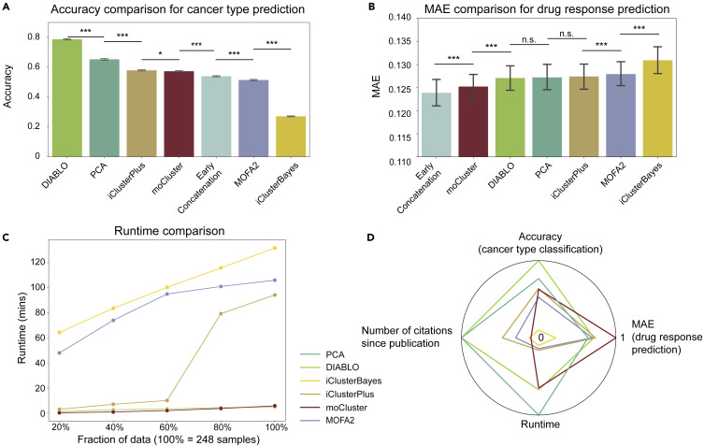
Integration approaches : the good one ?
Integration methods are not unique:
  comparisons exist... for a given application
  parametrization need expertise
Integration methods are not magic!
  check design and confounding factors
  perform specific data pre-processing for each omic
  impute missing values* (different meaning → different strategy)
  choose the integration strategy based on specific objectives and the data
  (ex. matching between omics) → still no standard pipelines
Cai Z, Poulos RC, Liu J, Zhong Q. Machine learning for multi-omics data integration in cancer. iScience. 2022

Slide 7
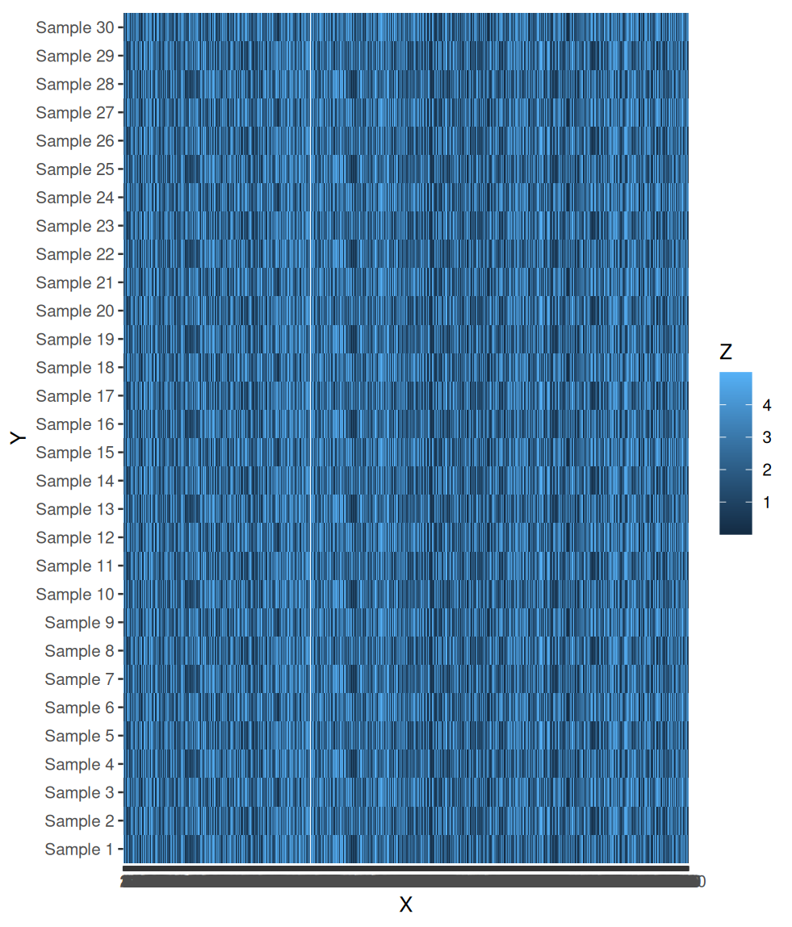
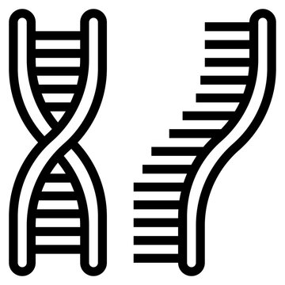
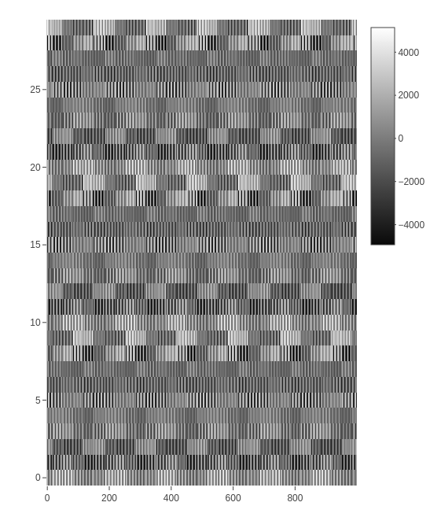
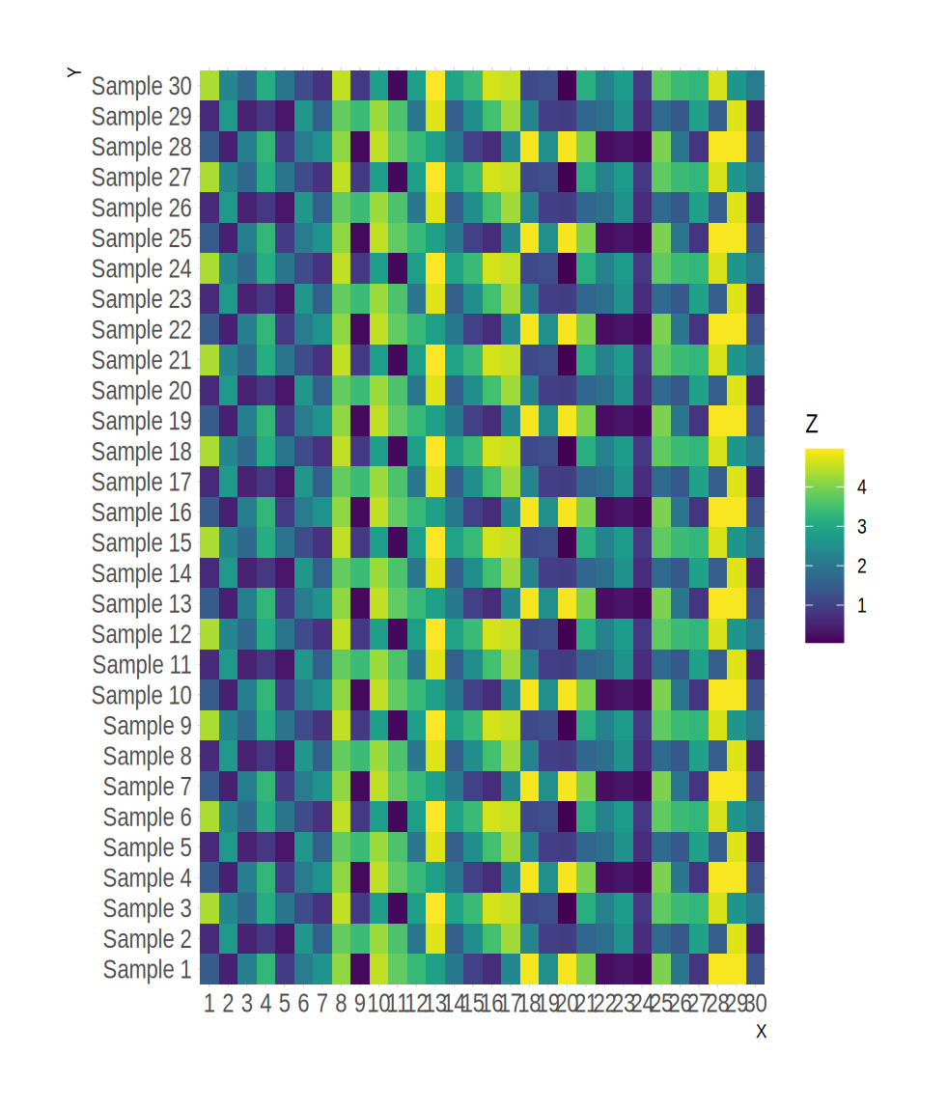

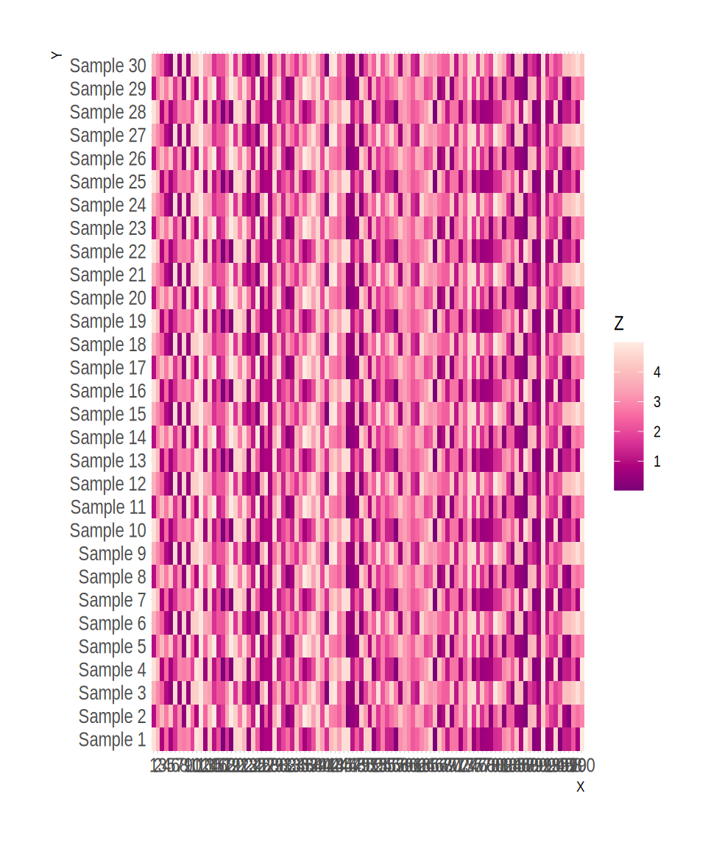

Integration strategies
​?
Inspired from: Picard M. et al. Integration strategies of multi-omics data for machine learning analysis. Comput Struct Biotechnol J. 2021.

Slide 8

Integration strategies - Late
Pros :
- avoid (numerous) challenges of direct omics integration
- use tools designed specifically for each omics
- classical approaches can be used to combine results
Cons :
- cannot capture inter-omics interactions
- complementarity information between omics is not exploited
+
+
Inspired from: Picard M. et al. Integration strategies of multi-omics data for machine learning analysis. Comput Struct Biotechnol J. 2021.
Notes:
Pros :
- avoid (numerous) challenges of direct omics integration
- use tools designed specifically for each omics
- classical approaches can be used to combine results
Cons :
- cannot capture inter-omics interactions
- complementarity information between omics is not exploited

Slide 9
Integration strategies - Early
.
Concatenate every omics datasets into a single large matrix.
Pros :
- conceptually simple
- easy implementation
- directly uncovers interactions between omics
Cons :
- technically complicated (noisy and high dimensional concatenated matrix)
- imbalanced omics datasets
- ignores the specific data distribution of each omics
- common definition space (rows or columns → samples or features)
Inspired from: Picard M. et al. Integration strategies of multi-omics data for machine learning analysis. Comput Struct Biotechnol J. 2021.
Notes:
Concatenate every omics datasets into a single large matrix.
Pros :
- conceptually simple
- easy implementation
- directly uncovers interactions between omics
Cons :
- technically complicated (noisy and high dimensional concatenated matrix)
- imbalanced omics datasets
- ignores the specific data distribution of each omics
- common definition space (rows or columns → samples or features)

Slide 10
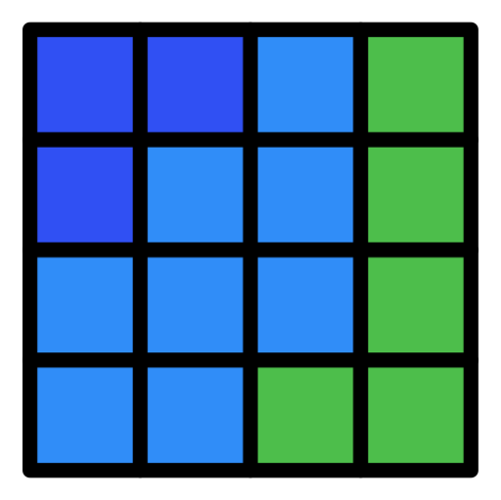
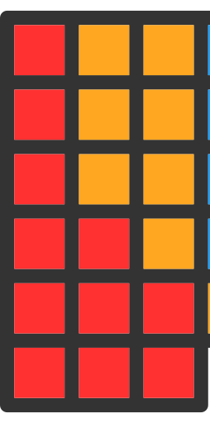


Integration strategies - Mixed
X
Jointly integrate the multi-omics datasets without prior transformation.
Pros :
- reduce information loss
- discover the joint inter-omics structure
- highlight the complementary information in each omics
Cons :
- could require robust pre-processing step to reduce heterogeneity
- common latent space assumption
Inspired from: Picard M. et al. Integration strategies of multi-omics data for machine learning analysis. Comput Struct Biotechnol J. 2021.
Notes:
Jointly integrate the multi-omics datasets without prior transformation.
Pros :
- reduce information loss
- discover the joint inter-omics structure
- highlight the complementary information in each omics
Cons :
- could require robust pre-processing step to reduce heterogeneity
- common latent space assumption

Slide 11
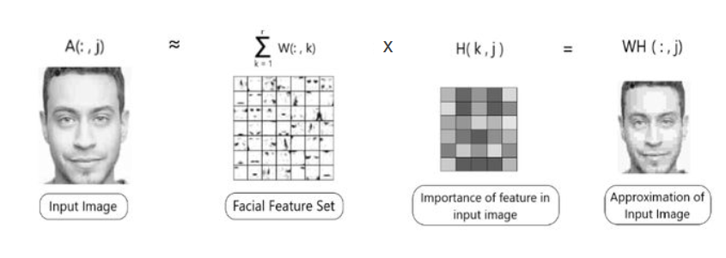
Integration strategies – Mixed: How does that work?

Slide 12
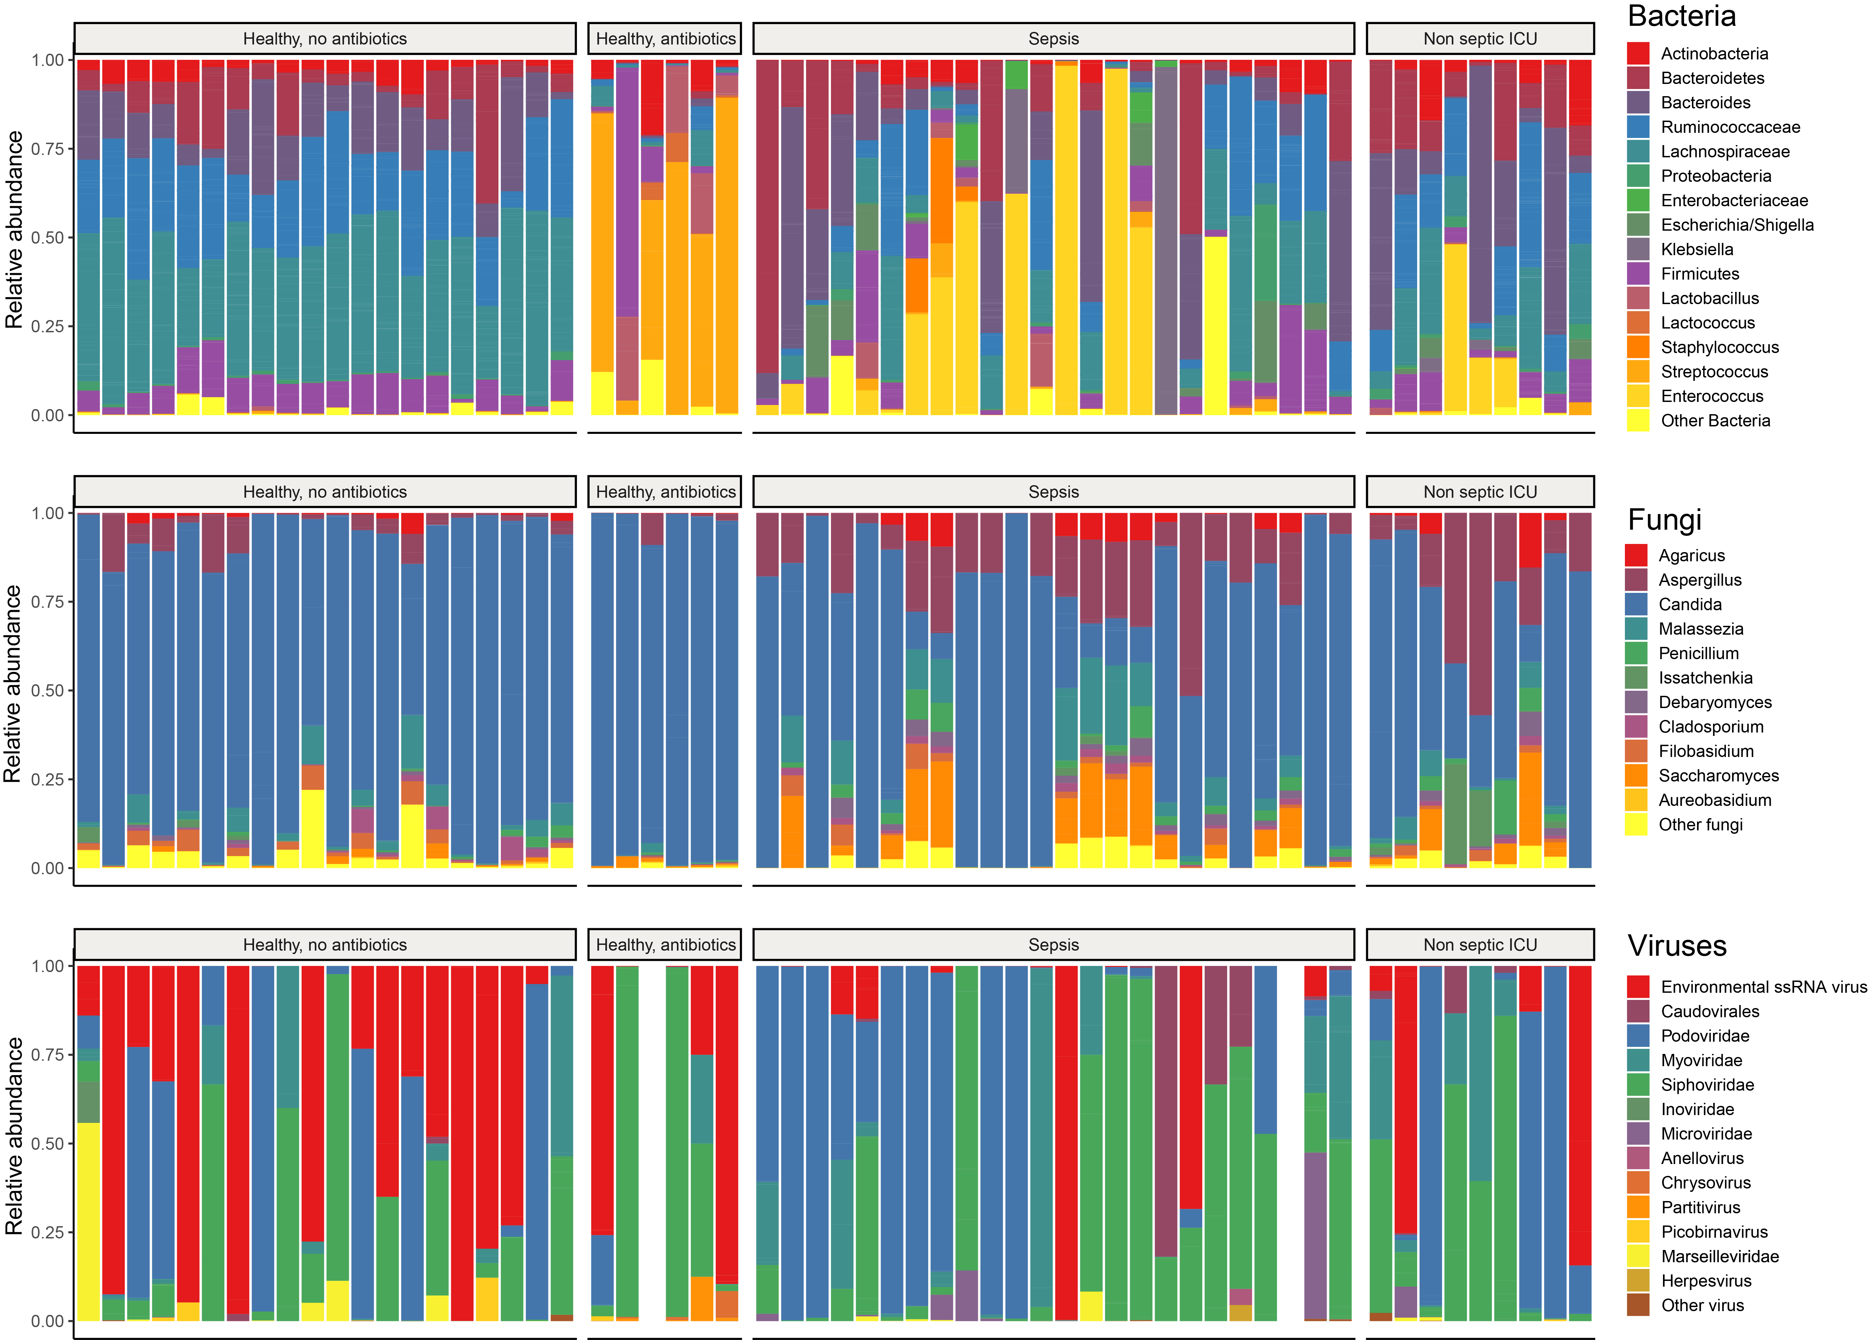
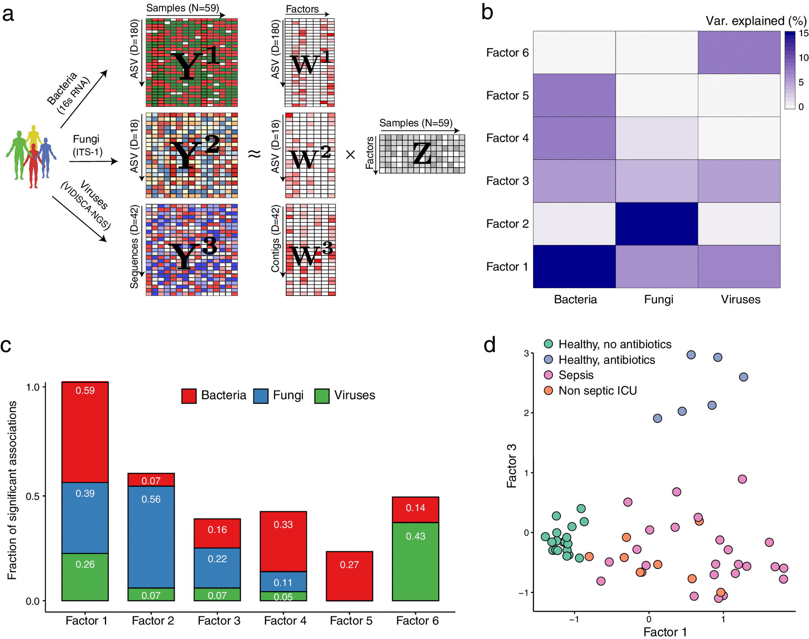
Integration strategies - Mixed
Haak, Bastiaan W., et al. "Intestinal transkingdom analysis on the impact of antibiotic perturbation in health and critical illness." bioRxiv (2020): 2020-06.
Notes:
Jointly integrate the multi-omics datasets without prior transformation.
Pros :
- reduce information loss
- discover the joint inter-omics structure
- highlight the complementary information in each omics
Cons :
- could require robust pre-processing step to reduce heterogeneity
- common latent space assumption

Slide 13
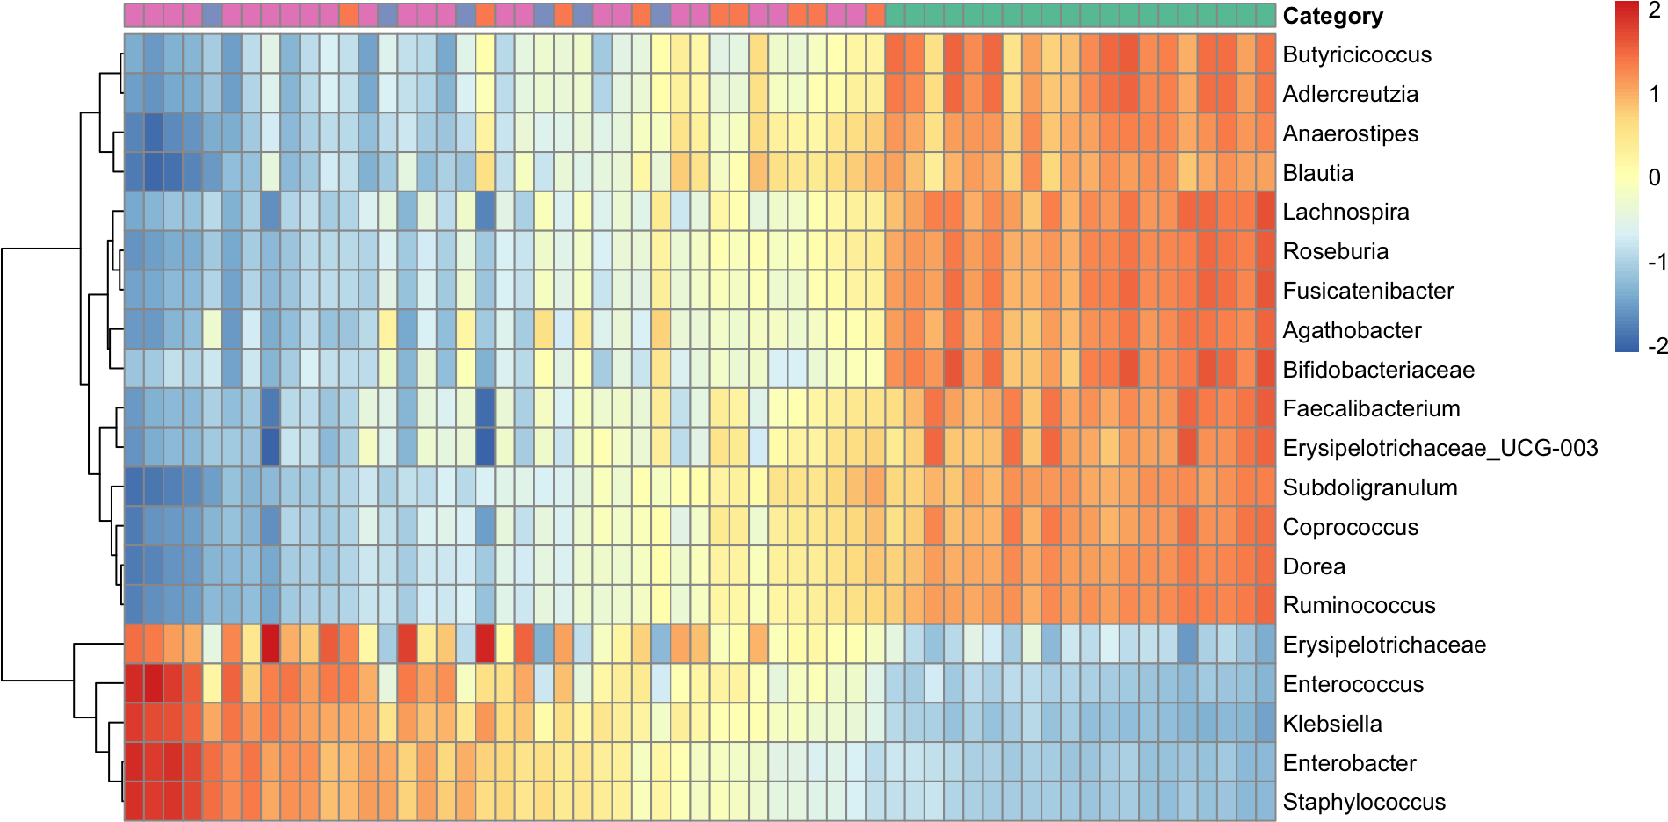
Integration strategies - Mixed
Sepsis
ICU
Healthy
Bacteria
Blue = negative influence on the categories
Red = Positive influence on the categories
Haak, Bastiaan W., et al. "Intestinal transkingdom analysis on the impact of antibiotic perturbation in health and critical illness." bioRxiv (2020): 2020-06.
Notes:
Jointly integrate the multi-omics datasets without prior transformation.
Pros :
- reduce information loss
- discover the joint inter-omics structure
- highlight the complementary information in each omics
Cons :
- could require robust pre-processing step to reduce heterogeneity
- common latent space assumption

Slide 14
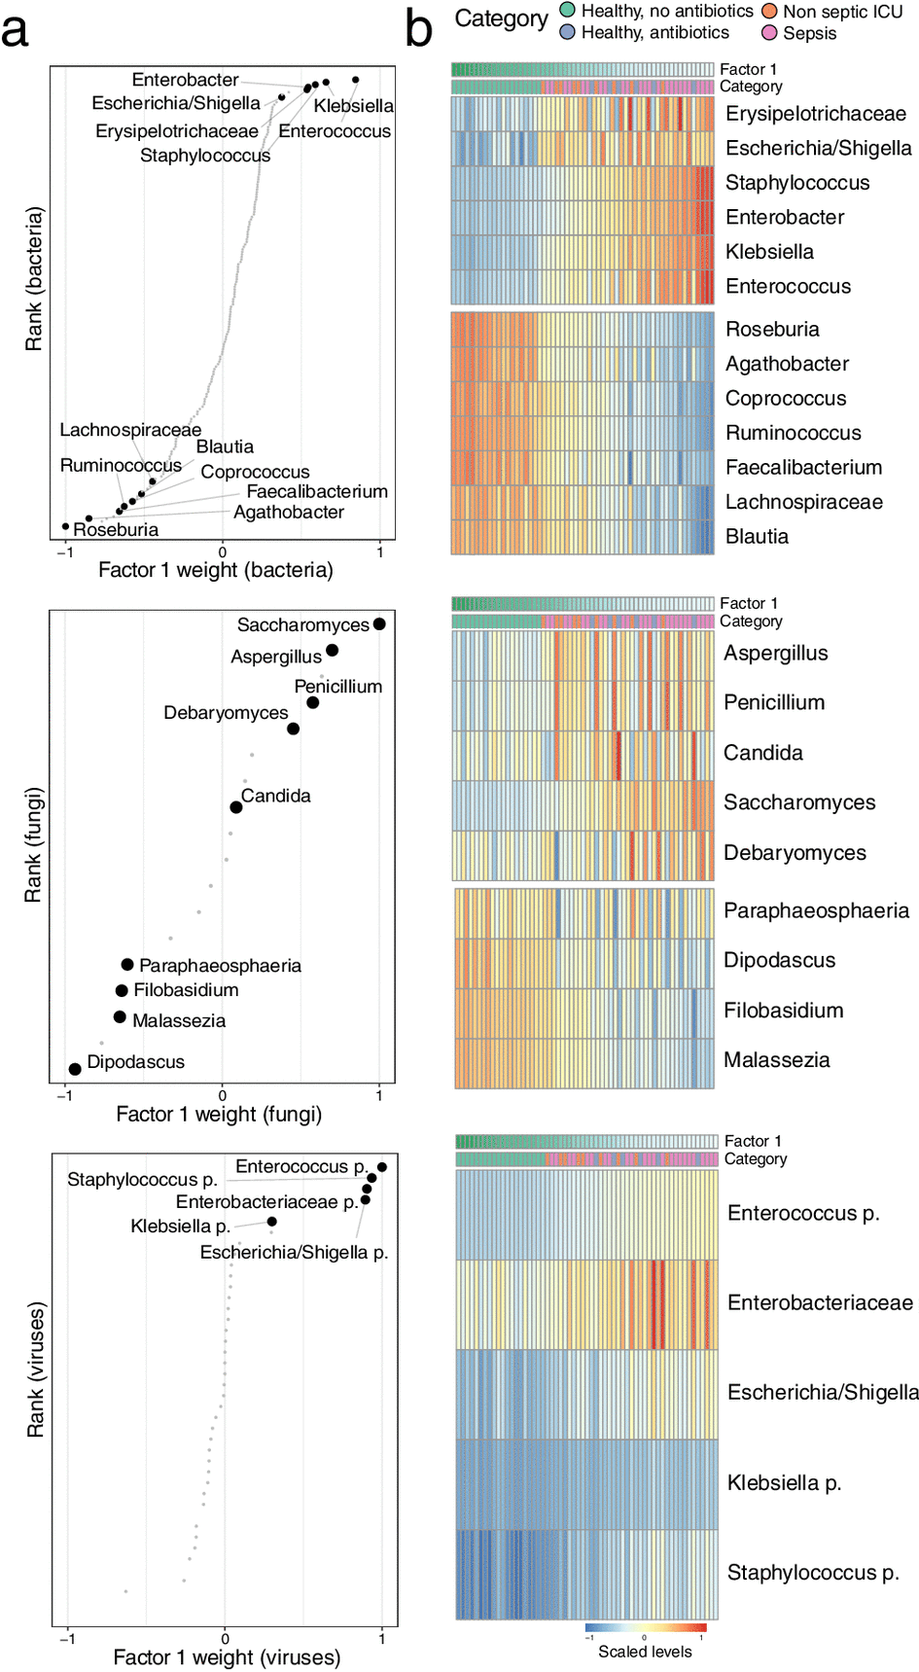
Integration strategies - Mixed
Haak, Bastiaan W., et al. "Intestinal transkingdom analysis on the impact of antibiotic perturbation in health and critical illness." bioRxiv (2020): 2020-06.
Notes:
Jointly integrate the multi-omics datasets without prior transformation.
Pros :
- reduce information loss
- discover the joint inter-omics structure
- highlight the complementary information in each omics
Cons :
- could require robust pre-processing step to reduce heterogeneity
- common latent space assumption

Slide 15
Integration strategies - Mixed
Cross kingdom metadata analysis
Haak, Bastiaan W., et al. "Intestinal transkingdom analysis on the impact of antibiotic perturbation in health and critical illness." bioRxiv (2020): 2020-06.
Notes:
Characterization of factor 4 as a microbiome response to cephalosporins and quinolones. (a) Analysis of the association between factors and antibiotic treatment. (Top) Pearson correlation coefficients between factor values and the antibiotic treatment indicator variables. (Bottom) Associated log10 FDR-adjusted P values. (b) Beeswarm and violin plots displaying factor 4 values, colored by cephalosporin (left) and quinolone (right) treatment. (c) Distribution of bacterial (left) and fungal (right) weights for factor 4. Labeled are representative bacteria and fungi among the largest weights. (d) Heat map displaying the reconstructed and scaled ASV levels (see Materials and Methods) for the bacteria labeled in panel c. (e) Scatterplot displaying the association between factor values and normalized ASV levels in Aspergillus. The line represents the linear regression fit, and the shading represents the corresponding 95% confidence interval. Pearson correlation coefficients and associated P values are displayed in the top left corner. Download FIG S6, TIF file, 2.1 MB.

Slide 16
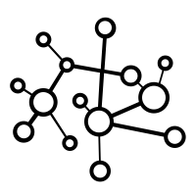
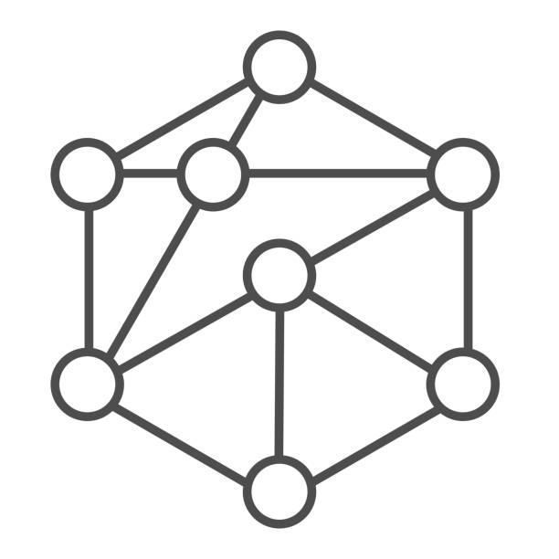
Integration strategies - Mixed
Transform independently each omics dataset into a simpler representation
before integration.
Pros :
- new representation is less dimensional and less noisy
- less heterogeneity between omics
- classical approaches can be used on combined representation
Cons :
- choice of the transformation method is not trivial
- information loss during transformation
- correspondence between omics in the new representation space
Notes:
Transform independently each omics dataset into a simpler representation
before integration.
Pros :
- new representation is less dimensional and less noisy
- less heterogeneity between omics
- classical approaches can be used on combined representation
Cons :
- choice of the transformation method is not trivial
- information loss during transformation
- correspondence between omics in the new representation space

Slide 17
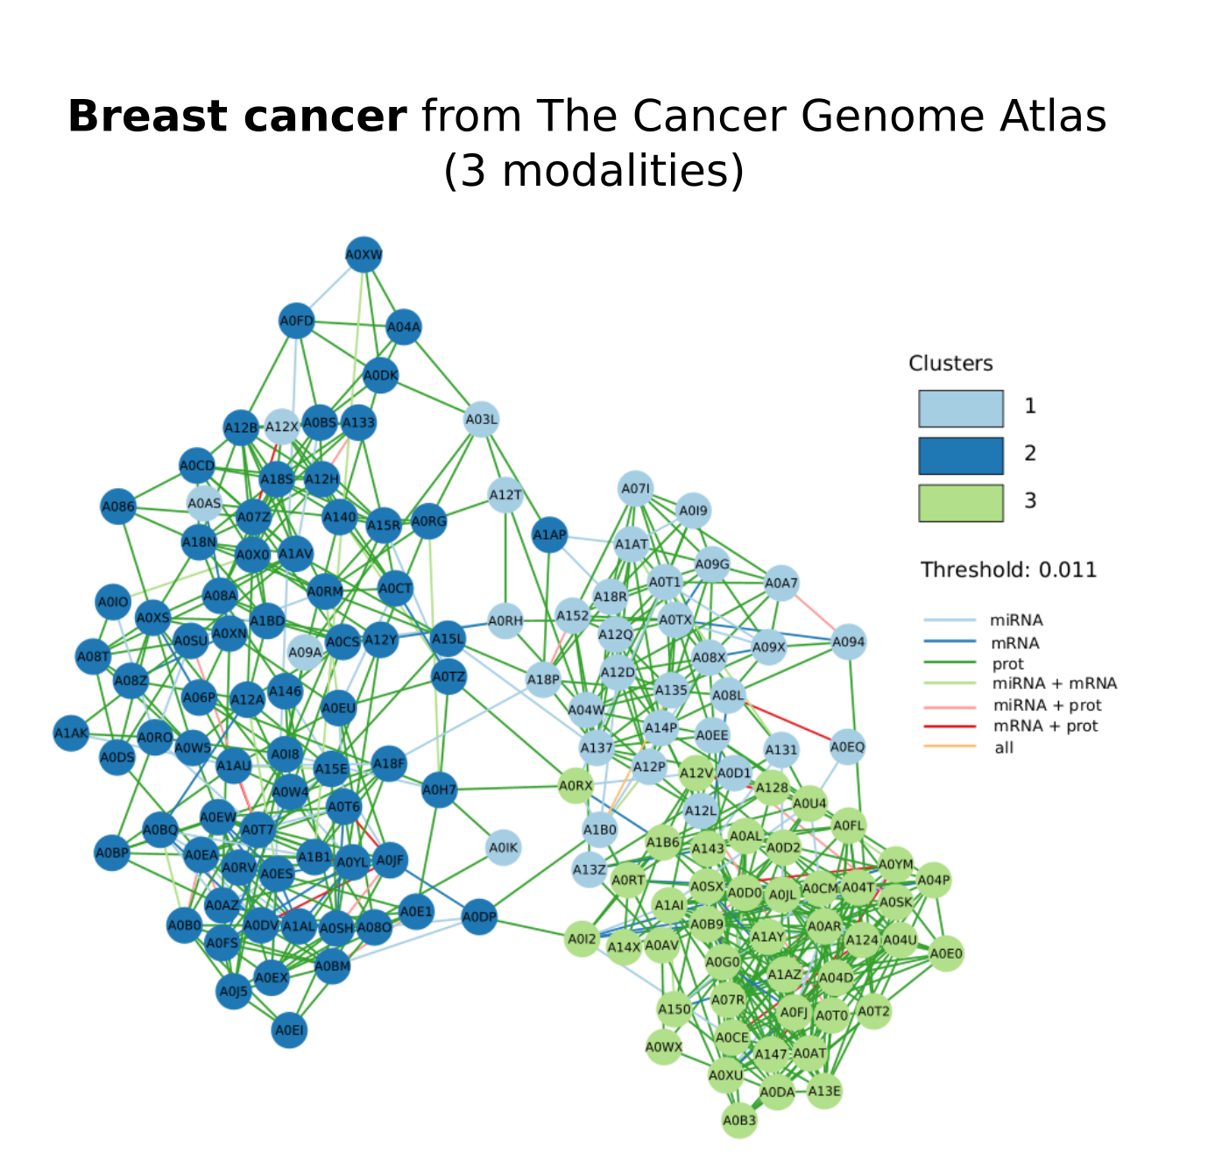
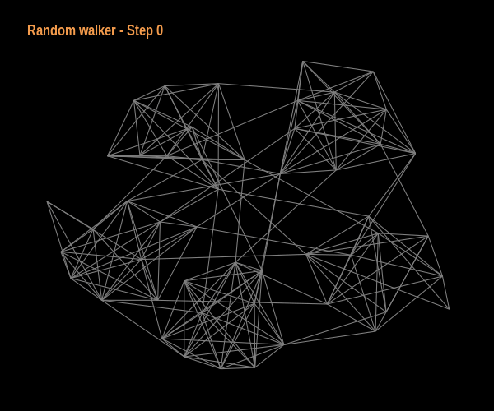
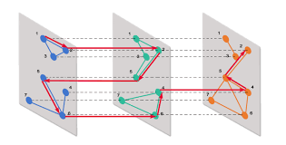
Integration strategies - Mixed
Community detection
Notes:
Transform independently each omics dataset into a simpler representation
before integration.
Pros :
- new representation is less dimensional and less noisy
- less heterogeneity between omics
- classical approaches can be used on combined representation
Cons :
- choice of the transformation method is not trivial
- information loss during transformation
- correspondence between omics in the new representation space

Slide 18
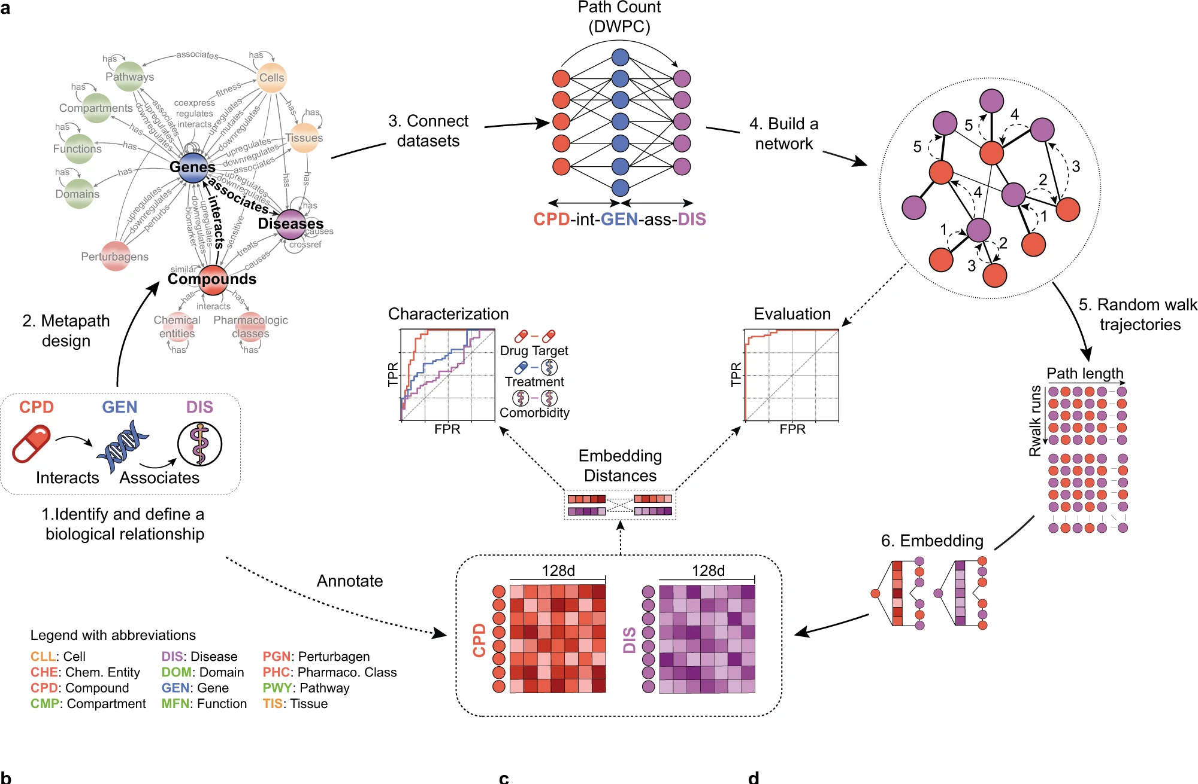
Semantic web / knowledge graph - applications
Scheme of the methodology. First, we define the biological entities (genes/diseases/compounds) to be connected and the specific context to be explored.
Then a source-target network is derived by traversing all the paths available from the source to the target nodes of a given metapath.
The vicinity of each node in the network is then explored by a random walker.
Finally, embeddings are evaluated and characterized.
Fernández-Torras, Adrià, et al. "Integrating and formatting biomedical data as pre-calculated knowledge graph embeddings in the Bioteque." Nature Communications 13.1 (2022): 5304.
Notes:
Transform independently each omics dataset into a simpler representation
before integration.
Pros :
- new representation is less dimensional and less noisy
- less heterogeneity between omics
- classical approaches can be used on combined representation
Cons :
- choice of the transformation method is not trivial
- information loss during transformation
- correspondence between omics in the new representation space

Slide 19
Take home message
Applications:
Integrative genomics aims to identify patterns, relationships, and interactions between genes, proteins, and other molecular components or organisms.
Design:
Metadata
- document everything for confounding effect
- metadata structure
Design in advance the analysis and the research questions – overview of the downstream analysis.
Notes:
Transform independently each omics dataset into a simpler representation
before integration.
Pros :
- new representation is less dimensional and less noisy
- less heterogeneity between omics
- classical approaches can be used on combined representation
Cons :
- choice of the transformation method is not trivial
- information loss during transformation
- correspondence between omics in the new representation space

